Slide 1

IST 687 Final Project “Crime in Boston”
Group 1: Jonathon Parry, Courtney Zimmer-Bartels, Kevin Vogel

Slide 2
Presentation Roadmap
Summary overview of the data:
Crime data → Kaggle
Weather data → NOAA
Questions to be answered:
Has there been an increase in crime?
Does crime occur more frequently at a certain time, day, week, or month?
Do warrants act as precursors for crime?
Is there a difference between the neighborhoods?
Is temperature a predictor of crime?
Conclusion

Slide 3
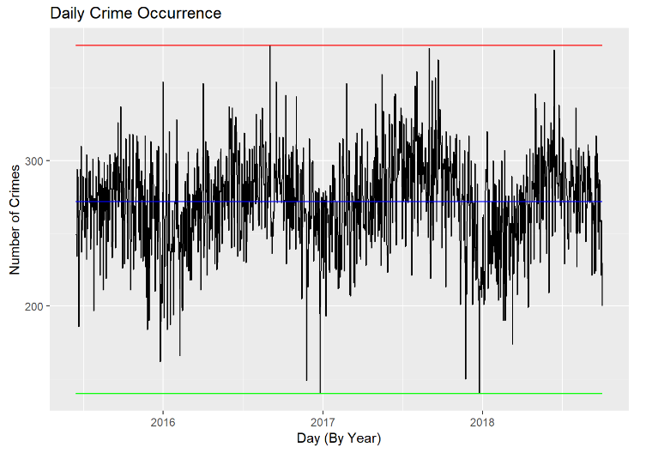
Summary Overview: Crime
Summary statistics
Total crimes: 327,820 crimes between June 2015 and October 2018
Mean: 271.6 crimes per day
Min/max: 140, 379 crimes per day
Median 273.0 crimes per day
Std Dev: 33.0 crimes per day
The police force
Size: 2,015 officers & 808 civilian personnel
3 shifts per day
24 hours per day
Assuming level scheduling, crime will vary from .14 – 0.40 crimes per day per officer; how can they manage their force given this variation?

Slide 4
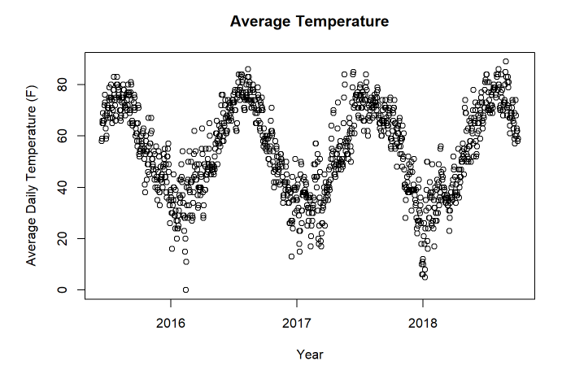
Summary Overview: Weather
Summary statistics for temperature in °F
Mean : 54.8
Min/Max: -9, 98
Mean daily min/max: 47.6, 62.6
Median: 56
Std Dev: 16.97
Summary statistics for precipitation in inches
Mean : 0.11
Min/Max: 0, 2.68
Median: 0
Std Dev: 0.29
This data was brought in to provide context to some of the trends we thought might emerge.

Slide 5
Has there been an increase in crime?
Count of daily crime was plotted on a timeline for the entirety of our dataset.
While there does seem to be a rather predictable rhythm to the seasonality of crime, the overall trendline over the course of 3+ years in Boston is flat.
While the number of law enforcement officers has increased, there is no statistically data that exists to suggest that crime on the whole has increased or decreased over the time period evaluated.

Slide 6
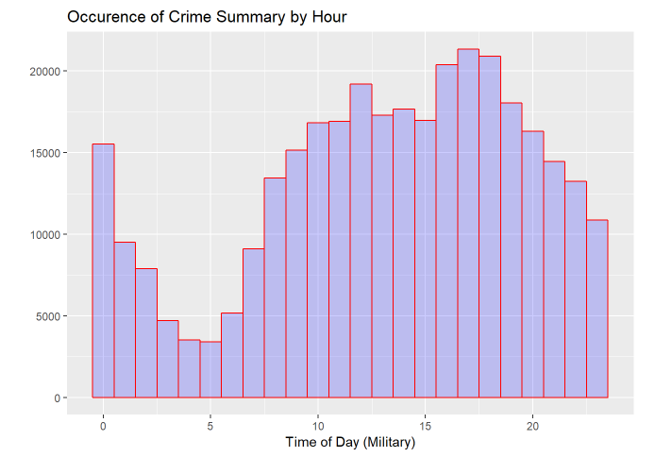
Does crime occur more frequently at a certain time, day, or month?
Crime rates reach their peak around 6 o’clock at night and are at their lowest in the early hours of the morning.
This suggests that there is a natural rhythm to crime that correlates with the circadian rhythm of Bostonians.
Interestingly, while the crime rate deceases from 6 o’clock to midnight, there is a sharp increase in crime during the first hour of the day. This lends credence to the old saying, “Nothing good happens after midnight.”

Slide 7
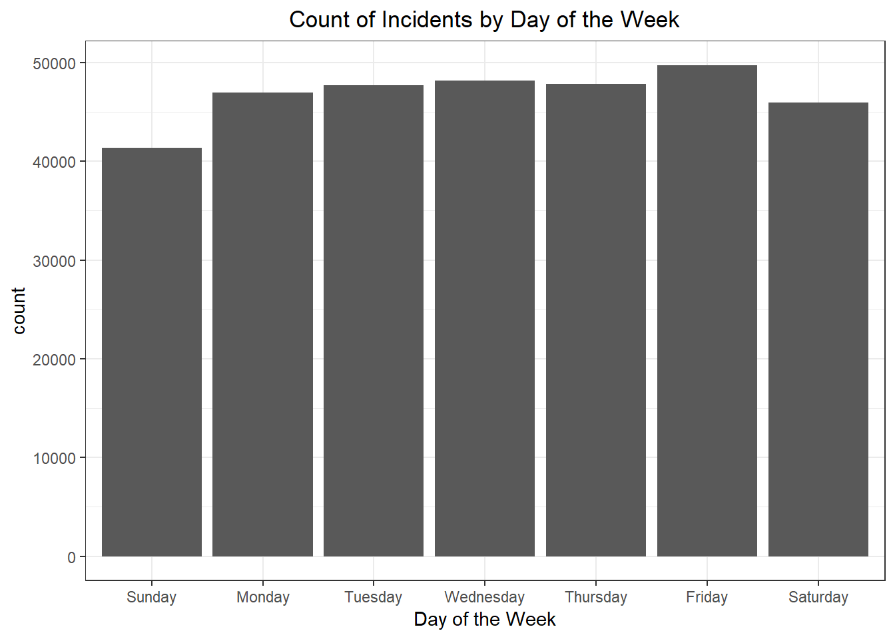
Does crime occur more frequently at a certain time, day, or month?
The safest day to be a Bostonian is Sunday by a wide margin whereas the most crime occurs on Friday.
With a 95% CI, there exists a statistically significant difference in the amount of crime that occurs on Friday and every other day of the week. The same holds true for Sunday.

Slide 8
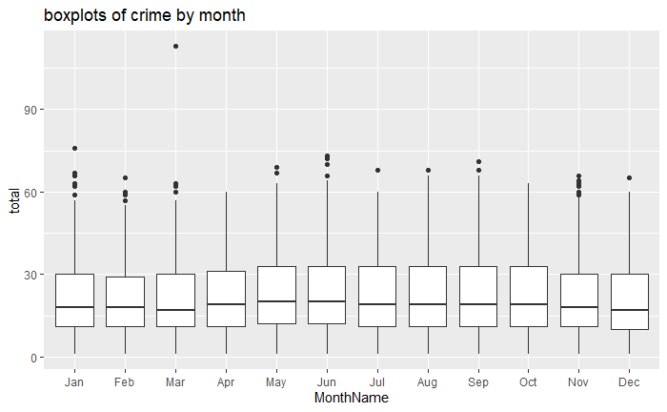
Does crime occur more frequently at a certain time, day, or month?
There is an increase in the amount of crime that occurs during the summer months.
This can be attributed to both the amount of daylight that exists – see summary by hour – and by the average temperature.
Human activity – criminal or otherwise – is higher during warm, daylight hours.

Slide 9
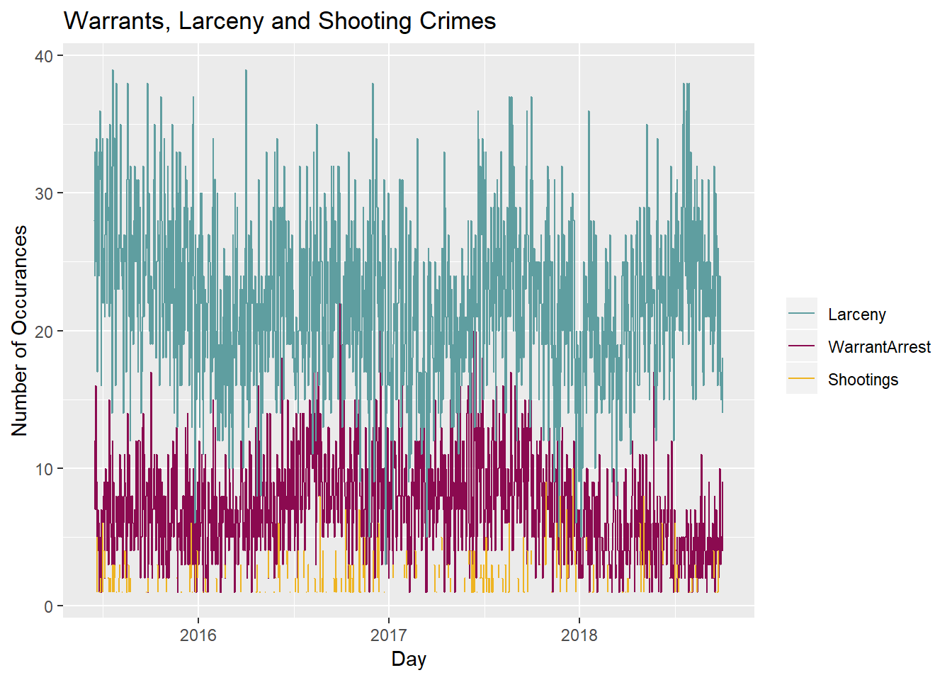
Do warrants act as precursors for crime?
The frequency by day of warrant arrest, larcenies and crimes that involve a shooting were graphed over the span of 4 years.
Both warrant arrest and larceny crimes have similar patterns of variation, however larceny crimes have more spikes. Specifically in late 2018, larceny has a signification increase, whereas warrant arrest has a decline.
There is no indication in our dataset that warrant arrest acts as a precursor for more serious offenses, such as larcenies.

Slide 10
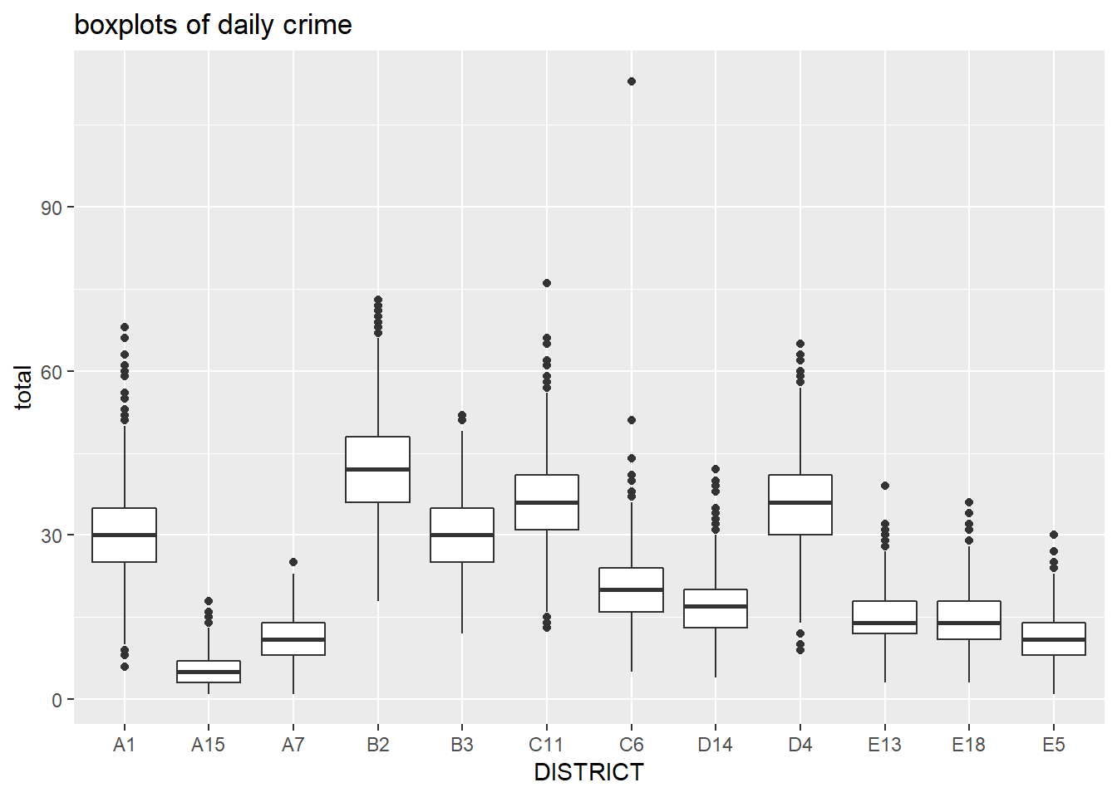
Is there a difference between the neighborhoods?
There is a large disparity between districts in Boston. The districts can be lumped into 3 categories that are distinctly unique from each other – high, middle, and low crime areas.
Districts A1, B2, B3, C11, and D4 constitute the high crime neighborhoods. It is less evident where
There is a statistical difference between the high crime neighborhoods and ALL of the other districts. These are the districts where law enforcement officers should be deployed most heavily.

Slide 11
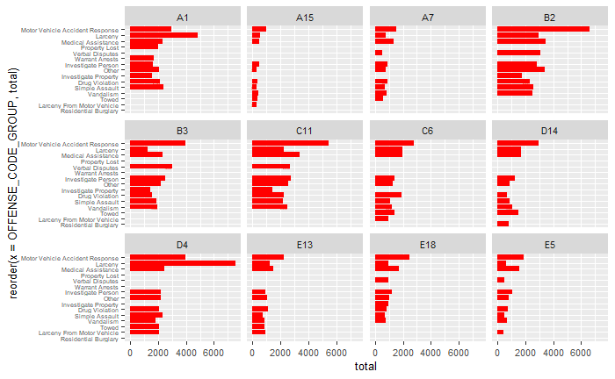
Is there a difference between the neighborhoods?
The 15 most prevalent crimes are depicted in the accompanying graph.
The count of larcenies appears to be highly correlated with whether a district is a high, middle, or low crime area.
The districts with the highest crime rates also had the highest rates of motor vehicle related incidents.

Slide 12
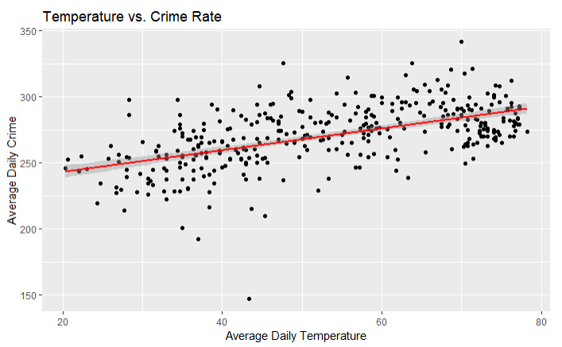
Is temperature a predictor of crime?
Linear modeling was used to determine if temperature had any predictive power for crime rate.
Statistically, it appears that a relationship exists given a statistically significant p-value. However, the Adjusted R-Squared was only 0.3069.
This modeling was expanded to include the addition of precipitation; an increase to 0.3246 Adjusted R-squared was observed.
A relationship appears to exist between temperature & precipitation and daily occurrences of crime.
An amount of variation exists that remains unexplained in our model.

Slide 13
Conclusion
Crime rates in Boston have been stable over time.
Crime rates vary most widely by district. The most dangerous areas to be in have not changed over time.
Some crime can be predicted by the amount of precipitation and temperature. Criminals do not like being cold or wet any more than non-criminals. Human activity levels are directly correlated to crime rates.
Crime rate is – very likely – an inherently flawed statistic. It comes as the result of policing; an increased amount of policing is likely to result in an increased crime rate. That does not mean that more crime is occurring, it just means that more people are getting caught. We did not have the data to correlate where law enforcement officers were deployed and when; this data would have provided us with more insight into the relationship between policing and crime rates.

Slide 14
Methodology
2 separate data sources were used in this project.
Crime rates in Boston and data from the NOAA were merged, providing us with one set of data to analyze.
Data cleansing was necessary as we were left with field type mismatches and null entries.
Initial summary statistics were performed to better understand the data that we had.
Common tools such as histograms, boxplots, and plots that incorporated time and trendlines were created to graphically understand our data.
As our data was incomplete for 2015 and 2018 some analysis was impossible to perform. Thus, we focused on daily crime rates as this allowed us to compare data over time.
Linear modeling was performed; however it was limited in scope as this was not taught until late in the course.

Slide 15
Structure of data
Crime Data
Weather Data
Name | Type | Description
OCCURRED_ON_DATE | POSIXct | YYYY-MM-DD noting when crime occurred
INCIDENT_NUMBER | chr | Accounting code for tracking
OFFENSE_CODE | num | Categorization code for offense
OFFENSE_CODE_GROUP | chr | Description of Offense Code
OFFENSE_DESCRIPTION | chr | Alternate Description of Offense Code
DISTRICT | chr | Location of crime based on chr num num (B14)
REPORTING_AREA | num | Numerical categorization of location (XXX)
SHOOTING | chr | NA or Y
YEAR | num | YYYY
MONTH | num | MM
DAY_OF_WEEK | chr | Monday, Tuesday, etc
HOUR | num | Military time of day
UCR_PART | chr | Uniform Crime Report (UCR) Categorization
STREET | chr | Street location of offense
LAT | num | Latitude location of offense
LONG | num | Longitude location of offense
LOCATION | chr | Combined latitude and longitude location
Name | Type | Description
Name | chr | Name of station reporting “BOSTON, MA US”
Date | Date | YYYY-MM-DD
Prcp | num | X.XX Amount of precipitation on that date
Snow |  | X.XX Amount of snow on that date
AvgTemp |  | XX Average temperature recorded that day
MaxTemp |  | XX Maximum temperature recorded that day
MinTemp |  | XX Minimum temperature recorded that day.

Slide 16
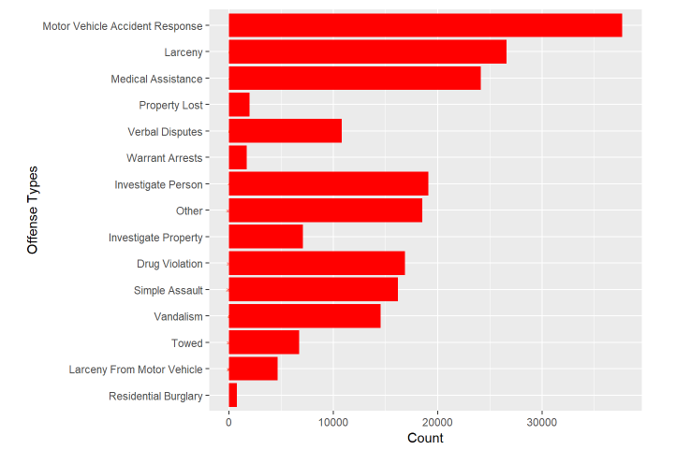
Top crimes
The top crimes in total for Boston are depicted in the graph to the right.

